Slide 1
Multi Layered Perceptron: Going Deep! (Neural Networks)
Amos Azaria
Notes:
Feed-forward network

Slide 2
Identifying Distance
Suppose we are given the following training set:
X = [[2,32], [25,1.2], [5,25.2], [23,2], [56,8.5], [60,60], [3,3], [46,53], [3.5,2]]
Y = [[1], [1], [1], [1], [1], [0], [0], [0], [0]]
How would you label:
[44,3]
[6,5]
What will our logistic regression model do?
Why? What might the weights be?
We need a more complex model!
One option is to add another feature:
|x_{i1}-x_{i2}|
(x_{i1}-x_{i2})²
But what will we do when it is not so clear which feature we need to add?
Notes:
In fact adding features was and still is a very common practice.

Slide 3
Logistic Regression
1st Feature
w₁
2nd Feature
b
sigmoid
w₂
output
w₃
3rd Feature
w₄
4th Feature

Slide 4
Adding a Hidden Layer
Forward-Propagation
w¹₁₁
b¹₁
1st Feature
h1
w²₁
w¹₂₁
w¹₁₂
2nd Feature
w¹₁₃
b¹₂
b²
sigmoid
w¹₂₂
w²₂
h2
output
w¹₁₄
w¹₂₃
3rd Feature
w¹₃₁
w¹₃₂
b¹₃
w²₃
w¹₂₄
w¹₃₃
h3
4th Feature
w¹₃₄
Back-Propagation (for gradient)

Slide 5

MultiLayer Perceptron (MLP)
The general concept comes from brain neurons, and the way the brain transmits information.
What will happen if the hidden unites are merely a linear combination?
The whole model remains a linear combination. We therefore need activation layers (next slide).
What happens if we set all initial values to 0?
We must randomize initial values, otherwise we will end up with identical neurons.
While the forward-propagation is more intuitive, the back-propagation is where things get complicated.
Fortunately, TensorFlow does all the hard stuff here…
We will discuss back-propagation at the end of the lesson.
Notes:
If you would like to invent new layers you must consider how the gradient will be computed.
But for most of the other cases, you can just treat it as a black box.
(Unless things don't work… vanishing gradient)

Slide 6
Activation Layers
Between every two linear layers, we must have an activation layer.
Activation layers include:
Logistic function
Step function
Tanh function
ReLU
Leaky ReLU
ELU
(Swish, SELU)
Notes:
Swish is sigmoid*ReLU
SELU is ELU multiplied by a lambda parameter

Slide 7
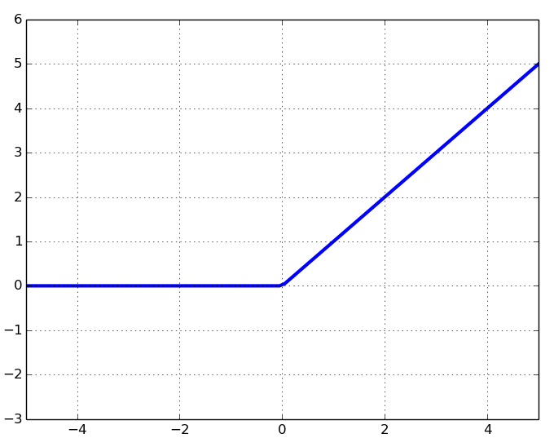
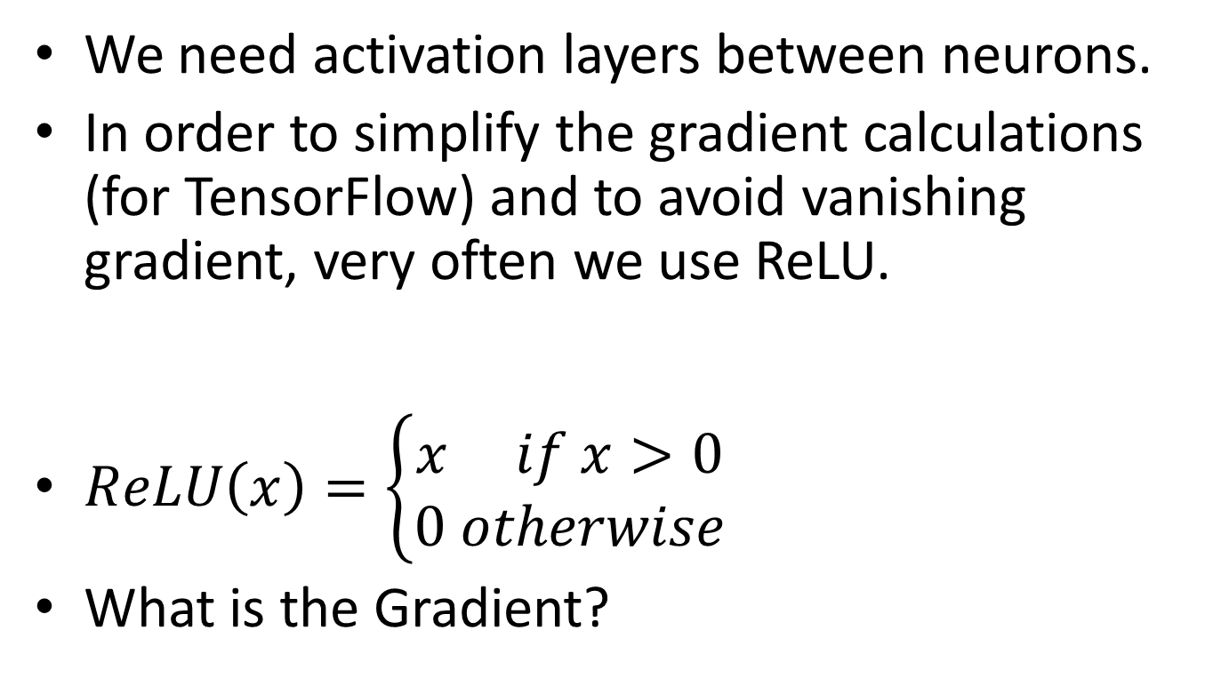
Rectified Linear Unit (ReLU)
We need activation layers between neurons.
In order to simplify the gradient calculations (for TensorFlow) and to avoid vanishing gradient, very often we use ReLU.
$ReLU\left(x\right)=\left\{\begin{aligned}x if x>0 \\ 0 otherwise\end{aligned}\right.$
What is the Gradient?

Slide 8
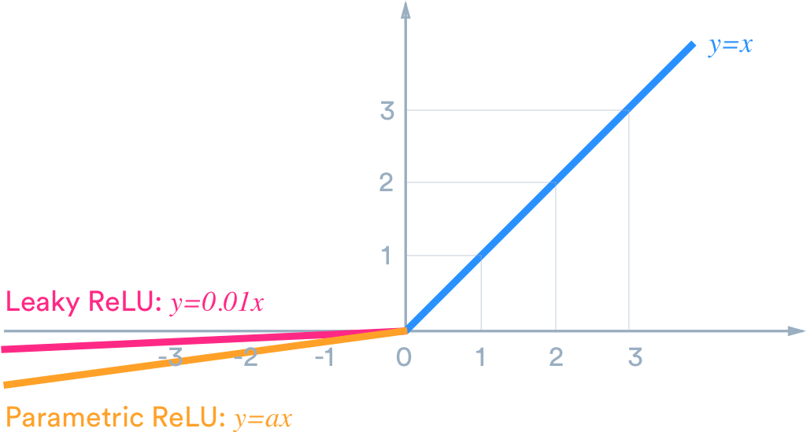

Leaky ReLU
$LReLU\left(x\right)=\left\{\begin{aligned}x if x>0 \\ αx otherwise\end{aligned}\right.$

Slide 9
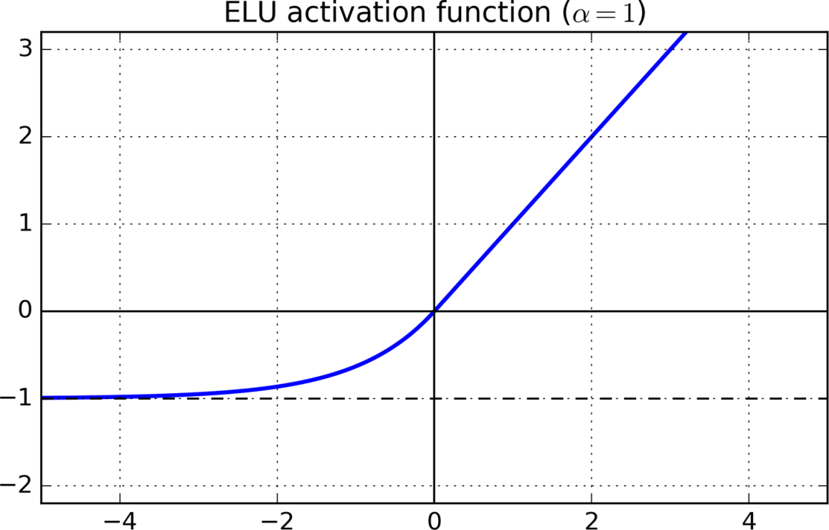

ELU
$ELU\left(x\right)=\left\{\begin{aligned}x if x>0 \\ α(e^{x}−1) otherwise\end{aligned}\right.$
Gradient?

Slide 10
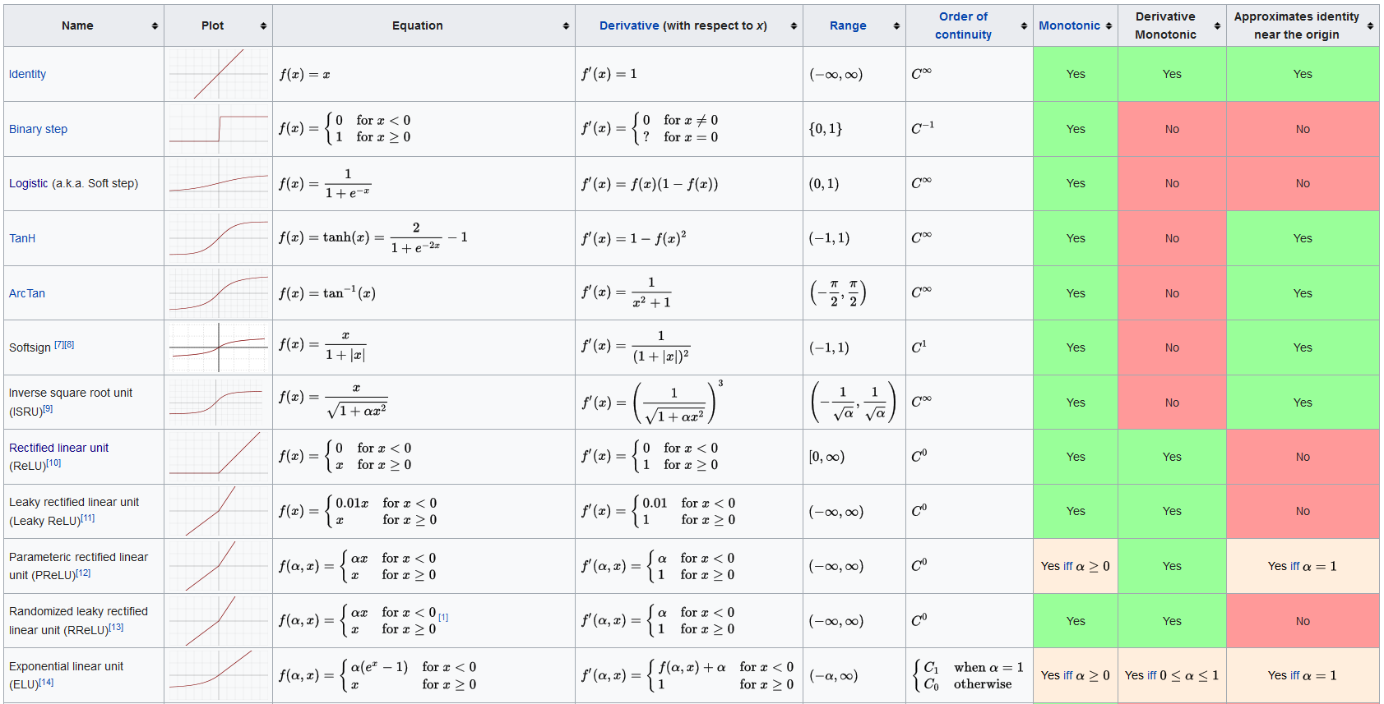
Source: wikipedia

Slide 11
MultiLayer Perceptron (MLP) in TensorFlow (For Identifying Distance)
features = 2
hidden_layer_nodes = 10
x = tf.placeholder(tf.float32, [None, features])
y_ = tf.placeholder(tf.float32, [None, 1])
W1 = tf.Variable(tf.truncated_normal([features,hidden_layer_nodes], stddev=0.1))
b1 = tf.Variable(tf.constant(0.1, shape=[hidden_layer_nodes]))
z1 = tf.add(tf.matmul(x,W1),b1)
a1 = tf.nn.relu(z1)
W2 = tf.Variable(tf.truncated_normal([hidden_layer_nodes,1], stddev=0.1))
b2 = tf.Variable(0.)
z2 = tf.matmul(a1,W2) + b2
pred = 1 / (1.0 + tf.exp(-z2))
loss = tf.reduce_mean(-(y_ * tf.log(pred) + (1 - y_) * tf.log( 1 – pred)))
update = tf.train.GradientDescentOptimizer(0.0001).minimize(loss)
data_x = np.array([[2,32], [25,1.2], [5,25.2], [23,2], [56,8.5], [60,60], [3,3], [46,53], [3.5,2]])
data_y = np.array([[1], [1], [1], [1], [1], [0], [0], [0], [0]])
sess = tf.Session()
sess.run(tf.global_variables_initializer())
for i in range(0,50000):
sess.run(update, feed_dict = {x:data_x, y_:data_y})
Note the added noise
W1 is a matrix
ReLU activation layer!
b1 is a vector
We give a positive bias to avoid dead neurons (common problem with ReLU)
b2 is a scalar
W2 is a vector
Remains unchanged
Notes:
Must randomize! Can't initialize with 0's!
We give a positive bias to avoid dead neurons (common problem with ReLU).
Truncated normal drops points with std greater than 2, and repicks them (95.45%).

Slide 12
Results
print('prediction: ', y.eval(session=sess, feed_dict = {x:[[13,12], [0,33], [40,3], [1,1], [50,50]]}))
[[ 0.28915617],
[ 0.92531013],
[ 0.96954721],
[ 0.45891964],
[ 0.0316313 ]]
Notes:
w11 = +1, w12 = -1, b = -9
w21 = -1, w22 = +1, b = -9
ReLU
w1 = +1, w2 = +1, b=-1
Sigmoid

Slide 13
Umbrella problem
Two features:
Umbrella: with umbrella (1) / without umbrella (0)
Rain: raining (1) / not raining (0)
Labels:
Umbrella(1), raining(1) -> good (1)
No umbrella(0), not raining(0) -> good (1)
Umbrella(1), not raining(0) -> bad (0)
No umbrella(0), raining(1) -> bad (0)
Clearly, also the umbrella problem cannot be solved without hidden layers.
Why?

Slide 14
Possible solution (manually assigning weights and biases)
A hidden layer with 2 neurons (ReLU activation) is enough.
h1 will return a positive value only for x=(1,1) [umbrella, rain]
h2 will return a positive value only for x=(0,0) [no umbrella, no rain]
The final layer will return a value close to 1 if h1 or h2 output a positive value, otherwise close to 0.
Solve on board.
While the “identifying distance” is slightly more complex, it can be solved in a similar manner (by using the weights to subtract both values and then detecting if the value is greater than 5 or less than -5)

Slide 15
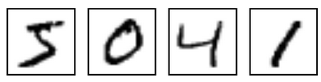
The MNIST Data-set
A data-set including hand written digits (with their correct label. Example:
There are 60,000 labeled images (50K train + 10K test)
We will start with a simple SoftMax network, then add some hidden layers, then introduce convolutional layers.
Some of the following slides are partially based on: https://www.tensorflow.org/versions/r0.9/tutorials/index.html

Slide 16
Basic SoftMax Only (no hidden layers)
from tensorflow.examples.tutorials.mnist import input_data
mnist = input_data.read_data_sets("MNIST_data/", one_hot=True)
x = tf.placeholder(tf.float32, [None, 784])
y_ = tf.placeholder(tf.float32, [None, 10])
W = tf.Variable(tf.zeros([784, 10]))
b = tf.Variable(tf.zeros([10]))
pred = tf.nn.softmax(tf.matmul(x, W) + b)
cross_entropy = tf.reduce_mean(-tf.reduce_sum(y_ * tf.log(pred), reduction_indices=[1]))
train_step = tf.train.GradientDescentOptimizer(0.5).minimize(cross_entropy)
init = tf.global_variables_initializer()
sess = tf.Session()
sess.run(init)
for i in range(1000):
batch_xs, batch_ys = mnist.train.next_batch(100) #MB-GD
sess.run(train_step, feed_dict={x: batch_xs, y_: batch_ys})
correct_prediction = tf.equal(tf.argmax(pred,1), tf.argmax(y_,1))
accuracy = tf.reduce_mean(tf.cast(correct_prediction, tf.float32))
print(sess.run(accuracy, feed_dict={x: mnist.test.images, y_: mnist.test.labels}))
We import the data from TensorFlow. We use one hot encoding
This is the first time we use a large data-set. Note the MiniBatch GD
Result:
0.9187
Note the use of the same graph also for test. (The test is calculated all at once)

Slide 17
Adding Two Hidden Layers
(hidden1_size, hidden2_size) = (100, 50)
x = tf.placeholder(tf.float32, [None, 784])
y_ = tf.placeholder(tf.float32, [None, 10])
W1 = tf.Variable(tf.truncated_normal([784, hidden1_size], stddev=0.1))
b1 = tf.Variable(tf.constant(0.1, shape=[hidden1_size]))
z1 = tf.nn.relu(tf.matmul(x,W1)+b1)
W2 = tf.Variable(tf.truncated_normal([hidden1_size, hidden2_size], stddev=0.1))
b2 = tf.Variable(tf.constant(0.1, shape=[hidden2_size]))
z2 = tf.nn.relu(tf.matmul(z1,W2)+b2)
W3 = tf.Variable(tf.truncated_normal([hidden2_size, 10], stddev=0.1))
b3 = tf.Variable(tf.constant(0.1, shape=[10]))
pred = tf.nn.softmax(tf.matmul(z2, W3) + b3)
cross_entropy = tf.reduce_mean(-tf.reduce_sum(y_ * tf.log(pred), reduction_indices=[1]))
train_step = tf.train.GradientDescentOptimizer(0.001).minimize(cross_entropy)
…
correct_prediction = tf.equal(tf.argmax(pred,1), tf.argmax(y_,1))
accuracy = tf.reduce_mean(tf.cast(correct_prediction, tf.float32))
for i in range (1000):
for _ in range(1000):
batch_xs, batch_ys = mnist.train.next_batch(100)
sess.run(train_step, feed_dict={x: batch_xs, y_: batch_ys})
print(i, sess.run(accuracy, feed_dict={x: mnist.test.images, y_: mnist.test.labels}))
Notes:
What will happen if we use tf.zeros(…) instead? Constantly receive 0.135 (in my case…)
Truncated normal drops points with std greater than 2, and repicks them (95.45%).

Slide 18
Results
(0, 0.3811)
(1, 0.60949999)
(2, 0.6961)
(3, 0.75199997)
(4, 0.78430003)
(5, 0.80739999)
(6, 0.82349998)
(7, 0.83639997)
(8, 0.84859997)
(9, 0.8563)
(10, 0.86549997)
…
(100, 0.94370002)
…
(200, 0.95880002)
(500, 0.97140002)
(700, 0.9734)
(800, 0.97329998)
(900, 0.97310001)
(930, 0.9738)
(931, 0.9734)
(996, 0.97390002)
(997, 0.97399998)
(998, 0.9738)
(999, 0.9738)
After 2 hours
0.9738!

Slide 19
Back Propagation

Slide 20
Adding a Hidden Layer
Forward-Propagation
w¹₁₁
b¹₁
1st Feature
h1
w²₁
w¹₂₁
w¹₁₂
2nd Feature
w¹₁₃
b¹₂
b²
w¹₂₂
w²₂
h2
output
w¹₁₄
w¹₂₃
3rd Feature
w¹₃₁
w¹₃₂
b¹₃
w²₃
w¹₂₄
w¹₃₃
h3
4th Feature
w¹₃₄
Back-Propagation (for gradient)

Slide 21
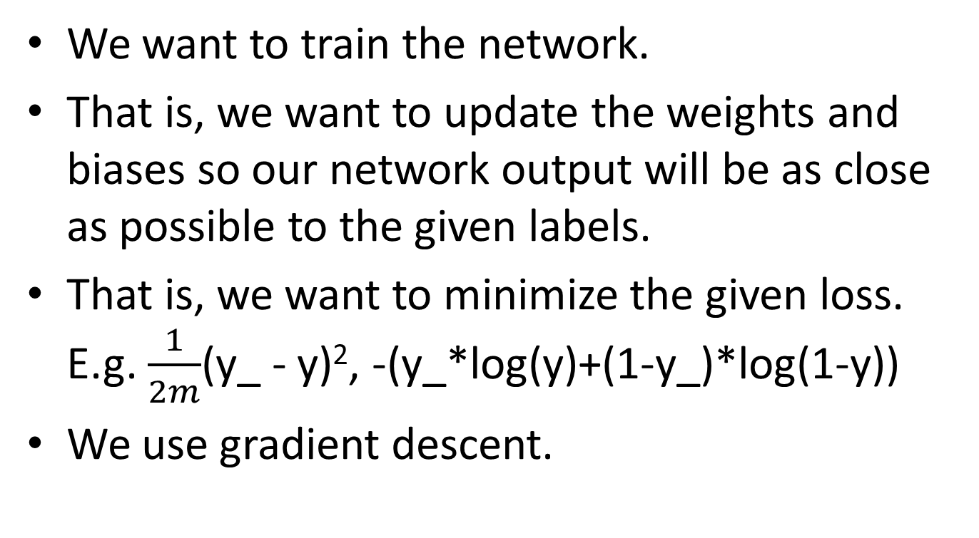
Why Back-Propagation? Our Goal.
We want to train the network.
That is, we want to update the weights and biases so our network output will be as close as possible to the given labels.
That is, we want to minimize the given loss. E.g. $\frac{1}{2m}$(y_ - y)², -(y_*log(y)+(1-y_)*log(1-y))
We use gradient descent.

Slide 22
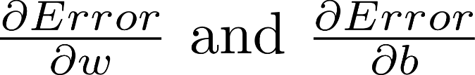
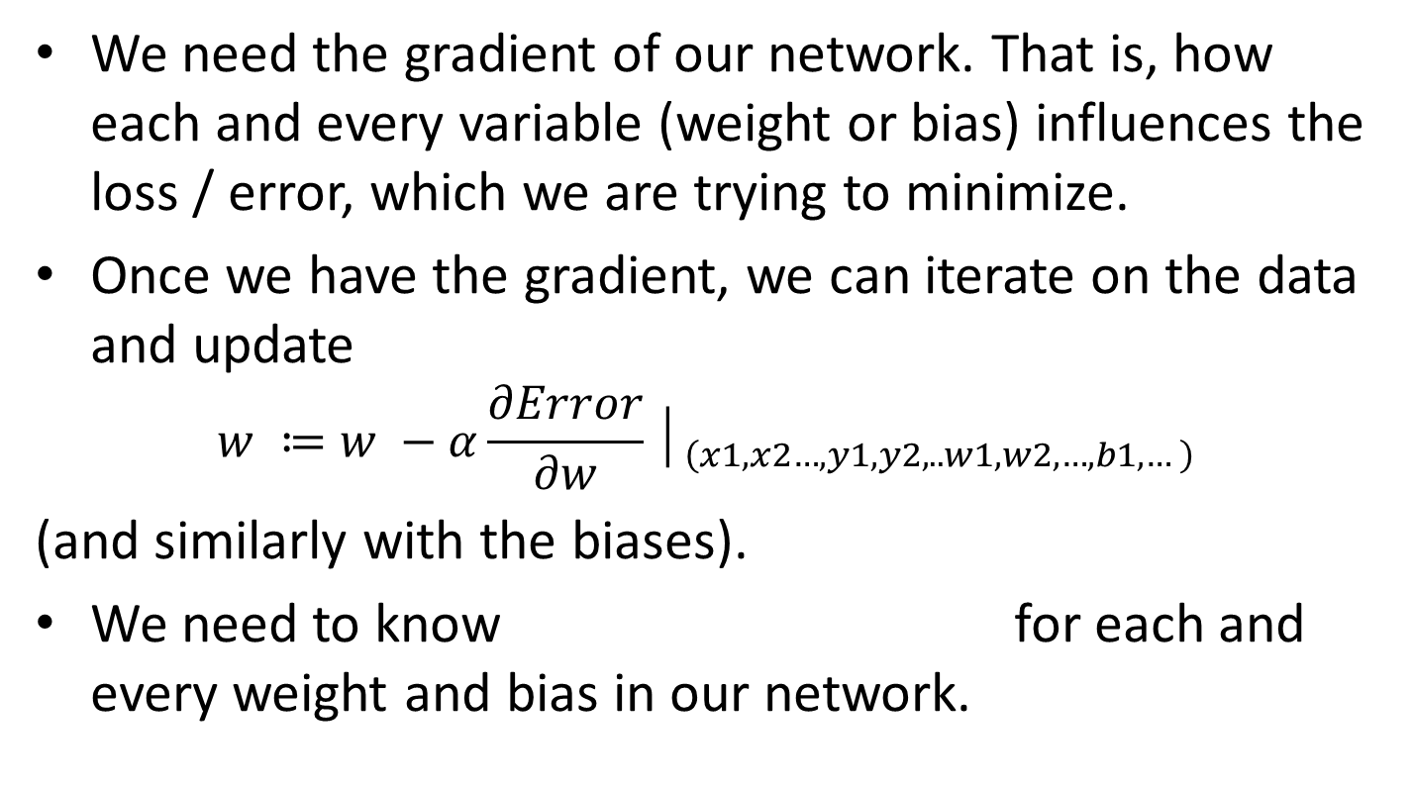
What Do We Need For GD?
We need the gradient of our network. That is, how each and every variable (weight or bias) influences the loss / error, which we are trying to minimize.
Once we have the gradient, we can iterate on the data and update
$$w ≔w −α\frac{∂Error}{∂w}│_{\left(x1,x2…,y1,y2,..w1,w2,…,b1,…\right)}$$
(and similarly with the biases).
We need to know for each and every weight and bias in our network.

Slide 23

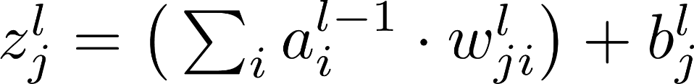
Notation
w^{l}_{jk}: weight at level l from node k (at level l-1) to node j (at level l)
b^{l}_{j}: bias of node j in level l
a^{l}_{j}: output of node j in level l (after activation)
z^{l}_{j}: input to activation:
- write z as a function of a w and b!

Slide 24
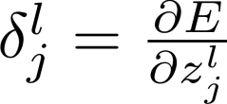
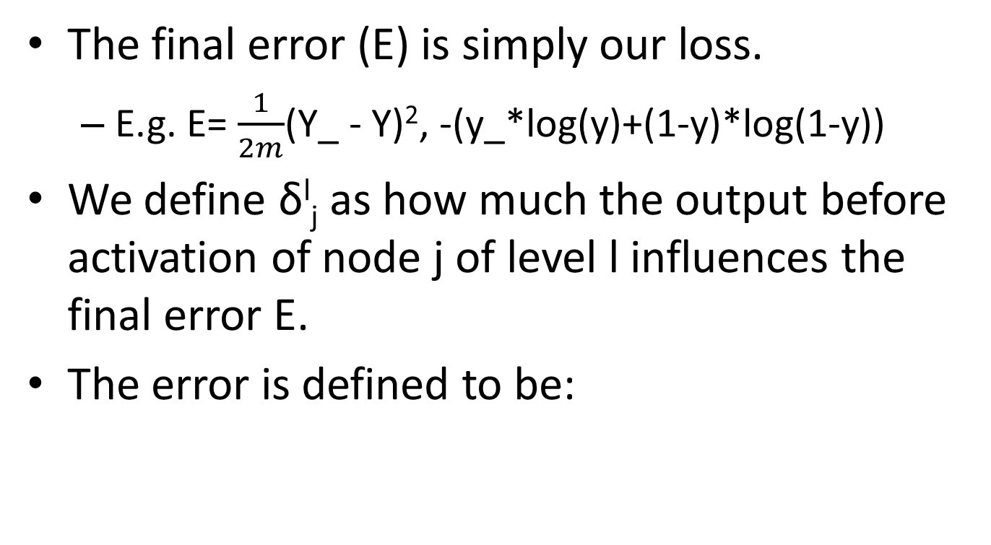
Delta Error
The final error (E) is simply our loss.
E.g. E= $\frac{1}{2m}$(Y_ - Y)², -(y_*log(y)+(1-y)*log(1-y))
We define δ^{l}_{j} as how much the output before activation of node j of level l influences the final error E.
The error is defined to be:

Slide 25
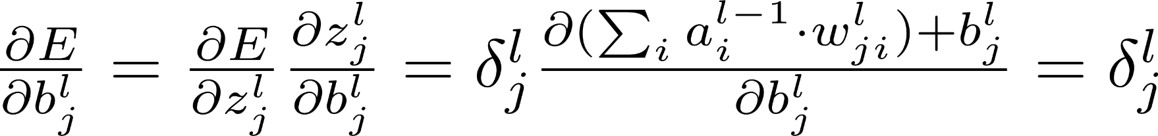
Suppose we had δ^{l}_{j}
If we had δ^{l}_{j} for every node in the network we could compute using the chain rule as follows:
This is ok because b_{j}^{l} influences E only via z_{j}^{l}
Again, E doesn't have any dependent on w_{j}^{l}_{k} other than z_{j}^{l}

Slide 26
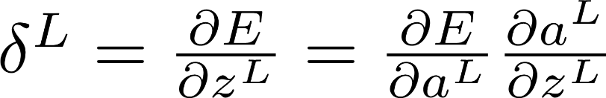
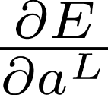
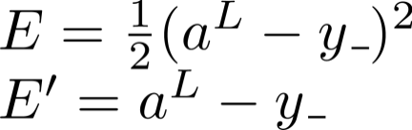
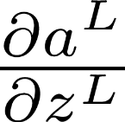
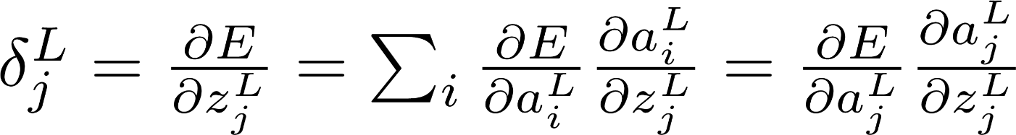
How Do We Obtain All δ^{l}_{j}?
We start with our last level (L).
If we have only a single output, it is simple:
is the derivative of the Error (loss function). E.g.
is simply the derivative of the activation function.
If we have more than a single output node: (e.g. softmax).
Total derivative

Slide 27
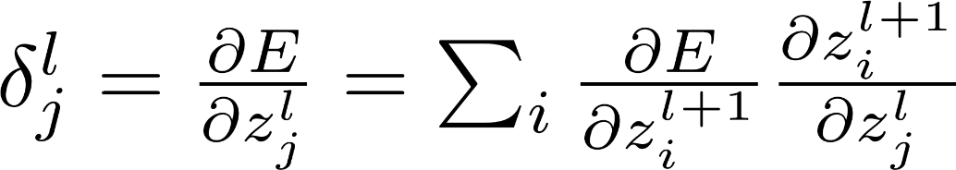
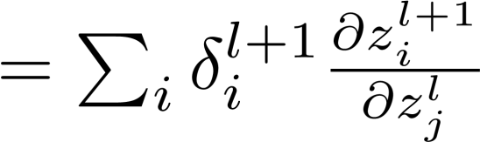
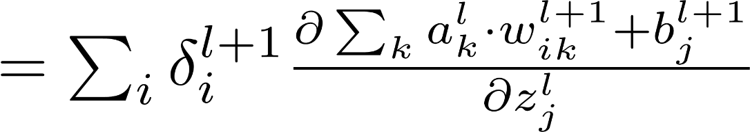
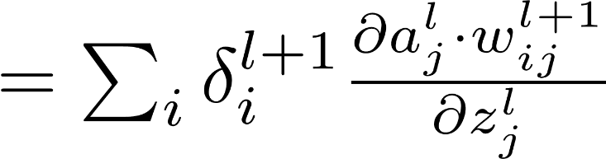
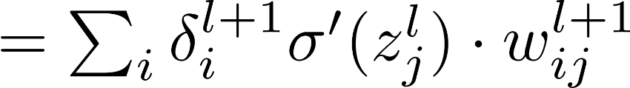
Obtaining δ^{l}_{j} for All Levels
We can now compute δ^{l}_{j} for every level, based upon δ^{l+1}.
Total derivative (summing the derivative of all partial derivatives)
Which term actually depends on z^{l}_{j}?

Slide 28
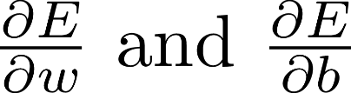
Operations on Matrices
All operations can be computed for each level at once.
This is much more efficient both algorithmically and hardware wise for current CPUs and especially GPUs.
Denote by δ^{l} all δ of level l (i.e. δ^{l}₁, δ^{l}₂, etc.).
We can (and should) use mini-batches and compute the average on all examples and only then perform a GD step. This takes additional advantages of matrix optimizations.

Slide 29


We Now Have an Algorithm!
Repeat until convergence:
For every example in data: (or better mini-batch)
Perform forwardprop. Get all z, a.
Compute E (final loss)
Compute δ^{L}
Compute all δ^{l}
Compute for all w and b:
Preform GD update. For all w, b:

Slide 30
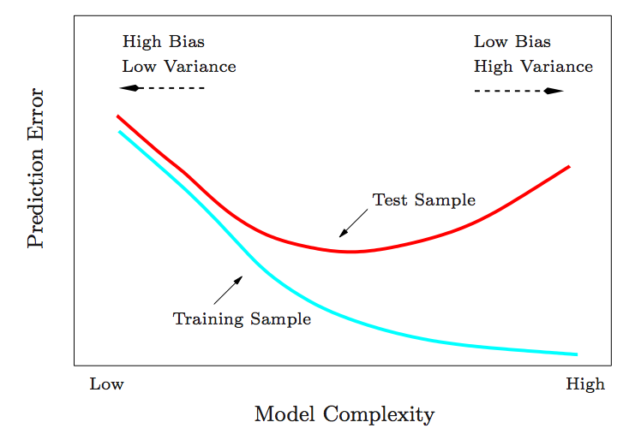
Train/Test error
Train and Test error are inherent measurements for debugging a machine-learning system, so I'm showing this slide again.
We should never expect the test error to be lower than the training error.
Unless we believe that we can solve the problem perfectly, we should expect some training error.
Credit: Collindcarroll.com

Slide 31
Bias / Variance: What to do?
What is "too high"?
If your train error is too high:
Many times a bug…
Train longer
Normalization
More complex model:
Add more layers or more features
Hyper-parameters tuning
Especially learning rate!
Optimization algorithm:
SGD, RMSProp, Adagrad, Adam
If your test error is too high (but train-error is ok):
More data
Early Stopping
Regularization:
Dropout (next week)
Ridge-LASSO
Under-fitting
Ask yourself, would you be happy with a system having that training error?
How well do humans perform?
You are over-fitting the data!

Slide 32
Batch-Normalization
Normalizing also the propagated data in the hidden layers.
Then adding back a new bias and variance that are learned parameters.
No need for the bias (b) anymore (it will be canceled anyway by normalization).
What do we do during test?
Use the average mean and variance collected during training (possibly by using a moving average, which we will see later).

Slide 33
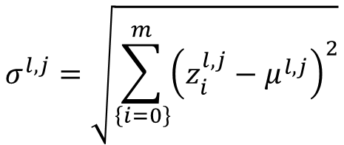


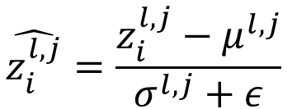
Batch-Normalization (Formulas)
$z_{i}^{l,j}$ is the i’th example’s input to activation function in layer l and neuron j
$μ^{l,j}=$ $\frac{1}{m}\sum_{\left\{i=0\right\}}^{m}{z_{i}^{l,j}}$
$$\hat{z_{i}^{l,j}}=\frac{z_{i}^{l,j}−μ^{l,j}}{σ^{l,j}+ε}$$
$$σ^{l,j}=\sqrt{\sum_{\left\{i=0\right\}}^{m}{{\left(z_{i}^{l,j}−μ^{l,j}\right)}^{2}}}$$
$$\tilde{z_{i}^{l,j}}=\hat{z_{i}^{l,j}}⋅γ^{l,j}+β^{l,j}$$
Important: note that we normalize across the different examples in the mini-batch (not across different neurons)

